Slide 1
The .NET Micro Framework and .NET Gadgeteer
.NET on tiny devices

Slide 2
NETMF: Many Form Factors
Traditional development board style
Arduino style
New .NET Gadgeteer style
Notes:
Show off actual boards during this part.

Slide 3
One Toolset
Visual Studio 2010 for NETMF 4.1 and 4.2
C# only for 4.1
C# and VB for 4.2
Open source Apache Licensed
Microsoft managed
Community contributions in core source tree
Anyone can port to any processor
Vendors provide NETMF libraries (called Drivers) for their own features
Notes:
Each MPU vendor has their own (often expensive) toolchain if you want to code natively. It’s more standardized when you get to the NETMF level

Slide 4
Architecture
Developer Workstation
Target Device
Your Source Code
Bootloader Firmware
Your .NET Code (IL)
and its required .NET libraries
Compiler
Loads
Deploys
To
NETMF Runtime
Deployment Tool
Interprets
Debugs
Debugger

Slide 5
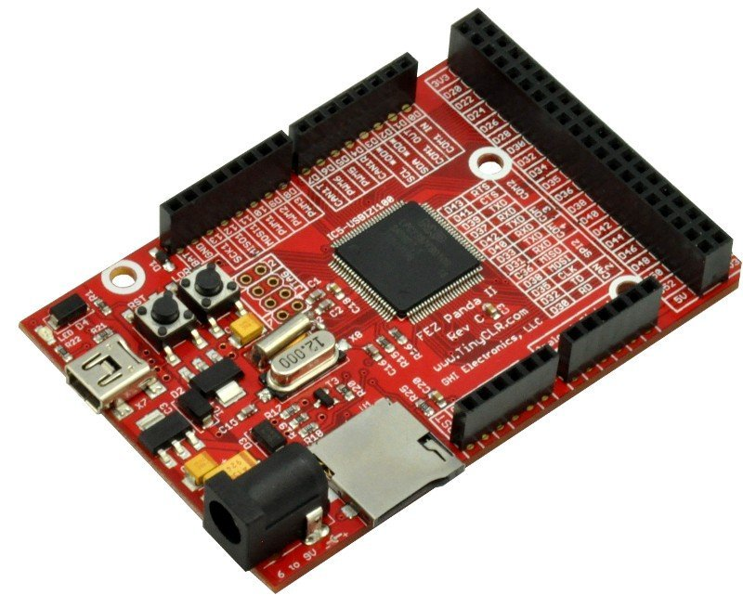
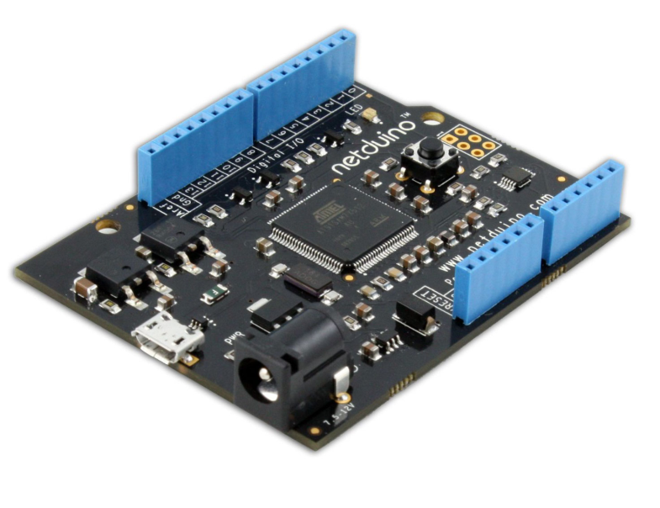
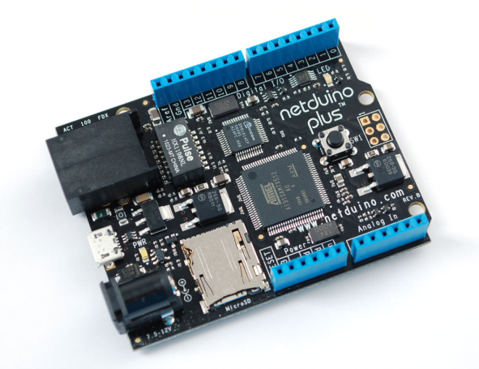
Arduino Form-Factor
Physical layout from Arduino
.NETMF instead of Wiring/Processing/C++

Slide 6
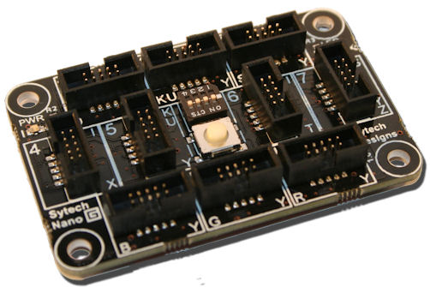
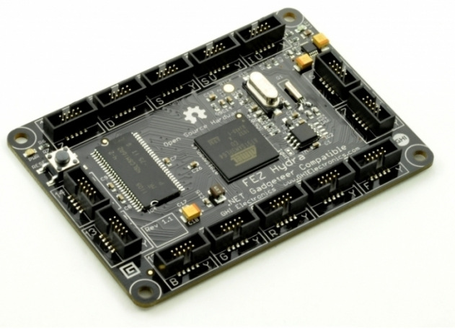
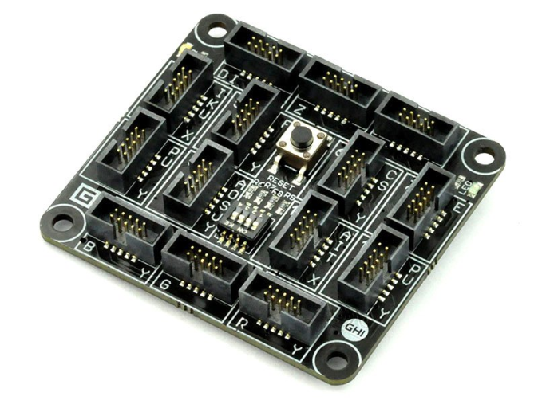
.NET Gadgeteer
Designed by Microsoft Research to lower barriers
Builds on .NET Micro Framework
Extensions to NETMF and Visual Studio
Open hardware specification

Slide 7
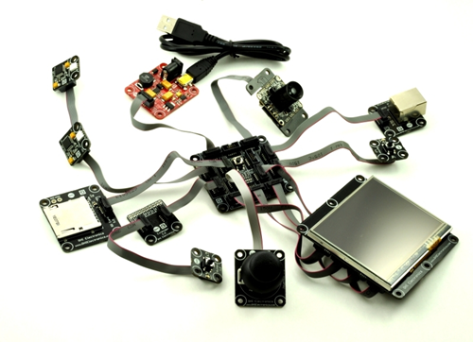
Gadgeteer Modules
Standardized socket types
Makes solderless projects possible
Visual Designer for connecting
Open hardware spec
Vendor-neutral

Slide 8
Target Audiences
Makers
Hobbyists
Education
Professionals prototyping new embedded solutions

Slide 9
What People like us are Making
Robots
CNC Machines
MIDI Controllers for music, and USB Audio Devices
Home monitoring and security
Azure and Pachube-connected sensor “Internet of Things” devices
Tiny Web Servers
Active Halloween Decorations
IR Helicopter Controllers
Automated Cameras
Build Machine Controllers
Weather Stations
Aquarium Controllers
Water cannons
Quadcopters
Hand-Held Game Devices
Clocks (binary, tube and more)
Creepy kids toys

Slide 10
What Microsoft is Making
Developer good will
VS2010 Express is free
No Money
There are no licensing costs
.NET MF is fully open source
You can even use MonoDevelop for Netduino development
Most users of NETMF are developers who already have C# skills
But we do attract some new blood to C#/.NET development

Slide 11
Why for you?
Rapidly prototype hardware ideas
Hone development skills
Low memory
Low CPU power
Like coding for the 6502 again!
Expand your horizons and geek out a bit
Without having to re-learn C or Assembly
Notes:
Have Andrew weigh in on the Low Memory/Low CPU with his encoding example

Slide 12
Why for new devs and your kids?
Build something cool
Automate something in your house
Lights, aquarium, a clock
Create some electronics you need
I’m building synthesizer-related things
Self-aware world-destroying robots
Gateway to electronics, robotics, *copters, and much much more
Learn .NET and Visual Studio while doing it
Obviously useful real-world skills

Slide 13
DEMO
Maybe I can blow something up

Slide 14
Summary
.NET in your pocket
An open-source, community-contribution success story for Microsoft
Friggin cool to play with
Small enough to sneak into the house without your Wife/Husband finding out

Slide 15
Where to find help
Micro Framework General
netmf.com
netmf.codeplex.com
.NET Gadgeteer
netmf.com/gadgeteer
gadgeteer.codeplex.com
Vendor Community Sites
tinyclr.com (GHI, primarily)
netduino.com (Secret Labs)
My Blog: 10rem.net
Will include any updated source/examples
Twitter: @pete_brown
Mail pete.brown@microsoft.com

